Slide 1
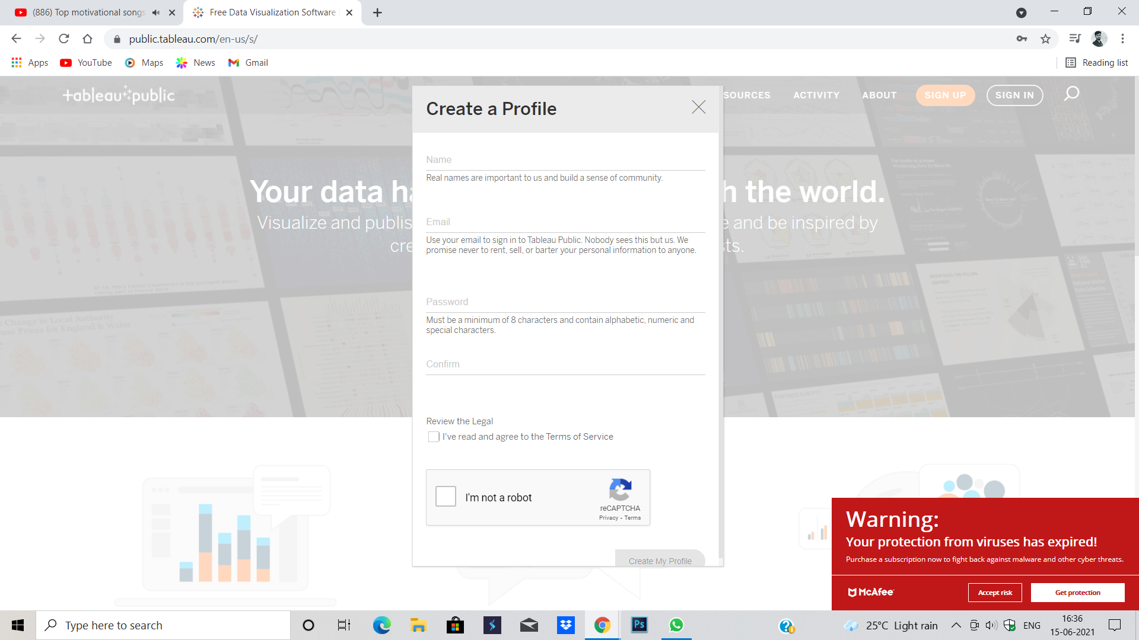
Create a profile .

Slide 2
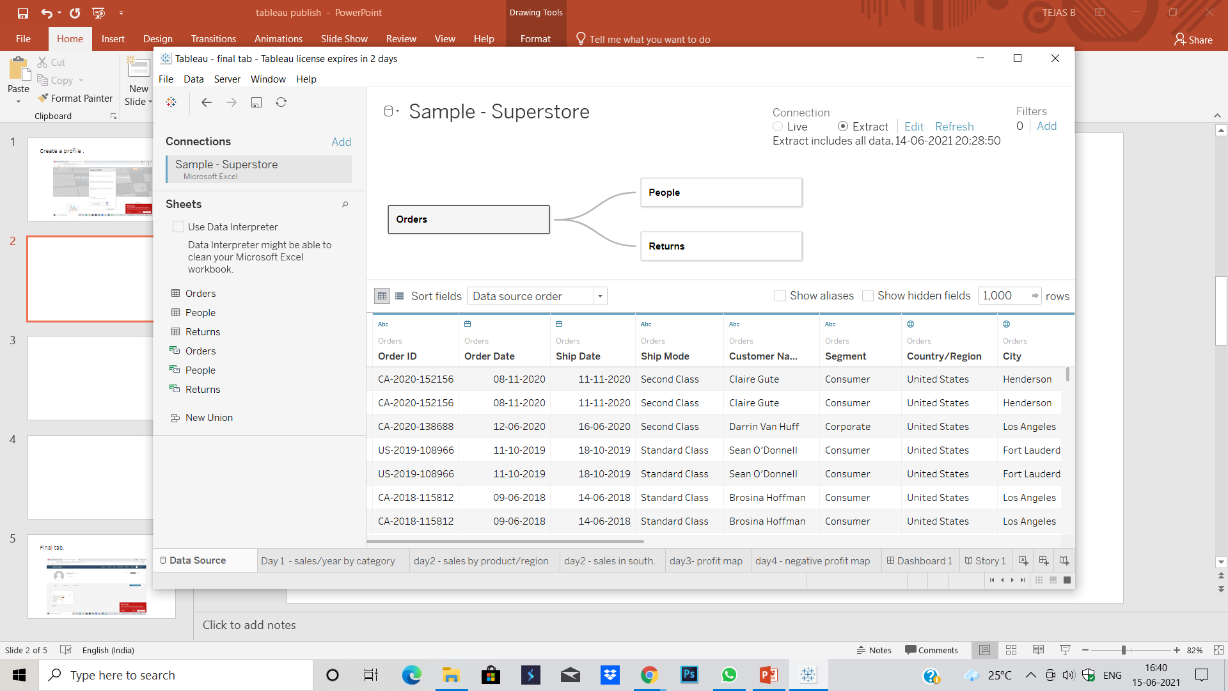
Change the connection from live to extract . A save location tab will pop up. Save it

Slide 3
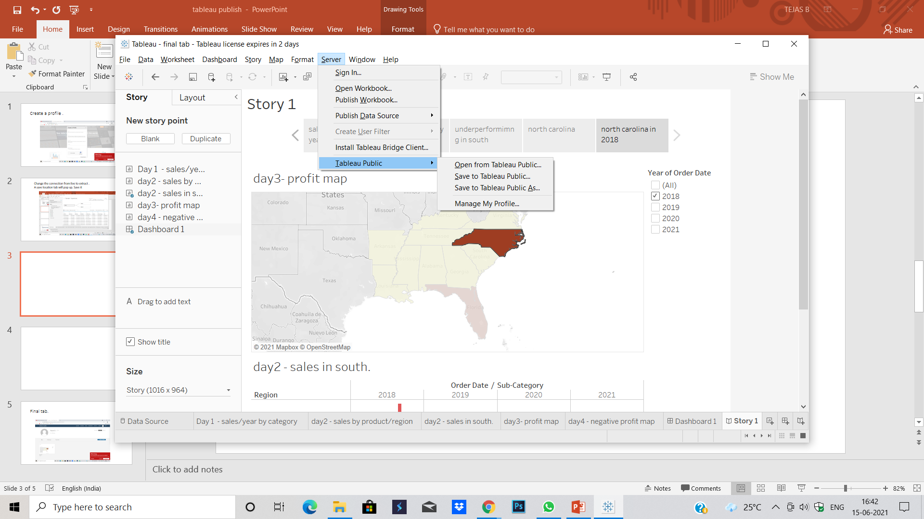
Click on server in the dialogue box

Slide 4
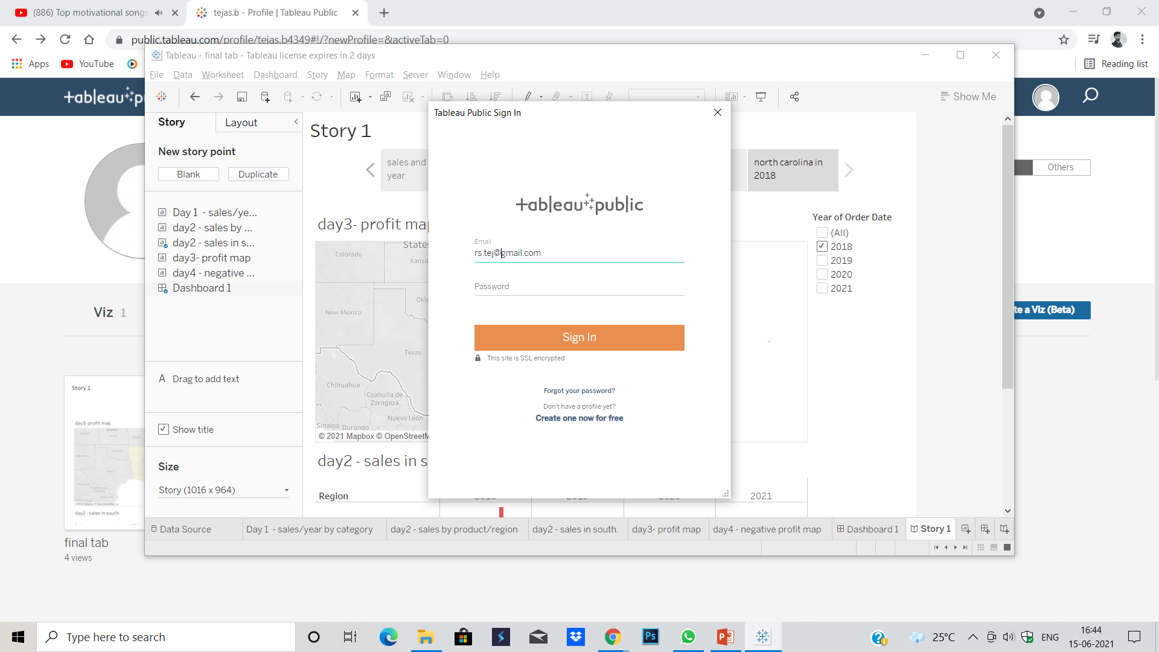
Sign in tab will pop up.

Slide 5
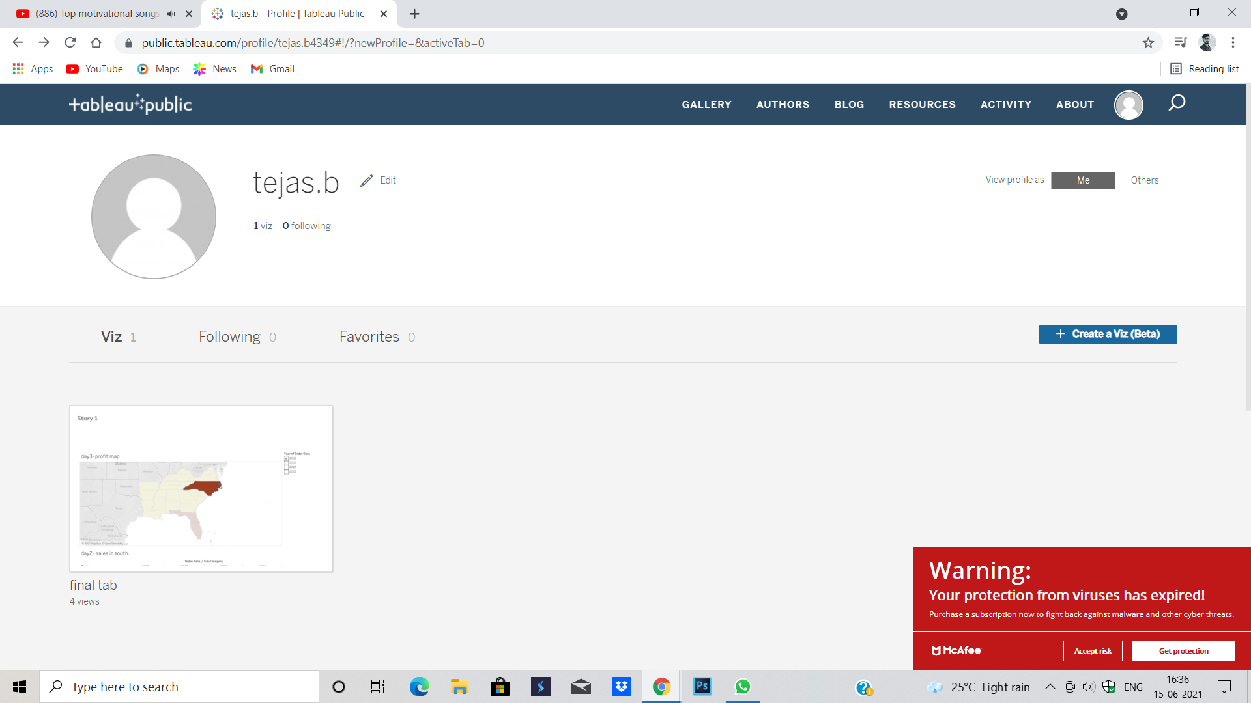
Final tab.

Slide 6
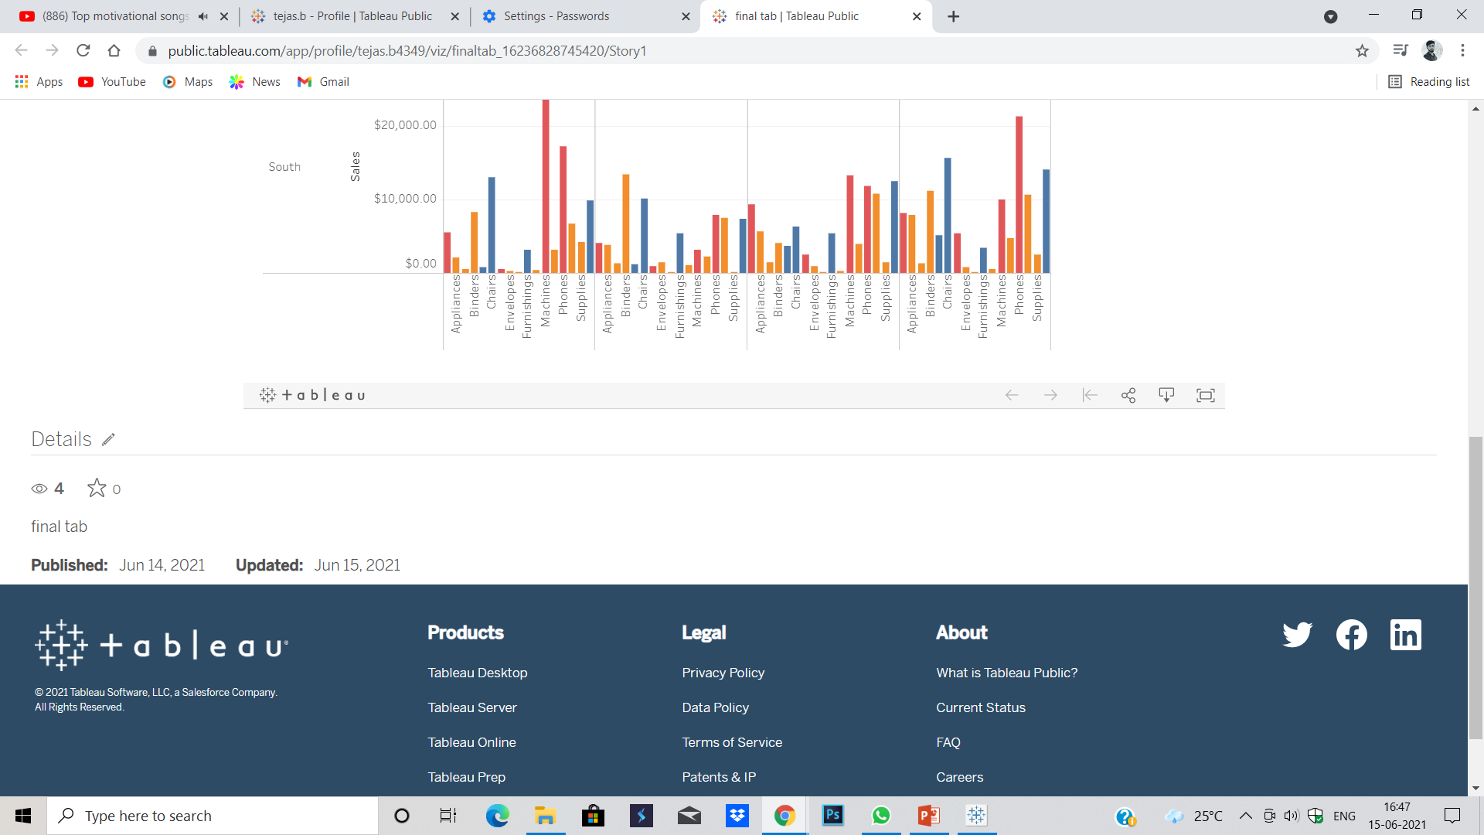
Click on share icon.

Slide 7
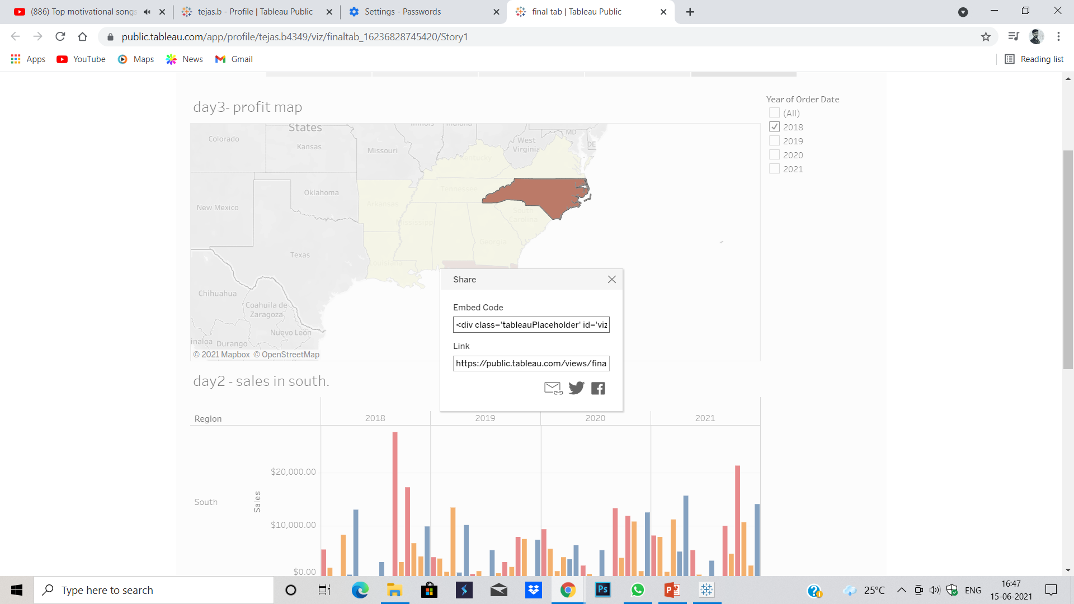
Copy the link and share it.

